Slide 1


OneHood Community Chatboard
OneHood is a verified-only hyperlocal community platform designed to promote secure and meaningful interactions among neighbors. By addressing concerns related to anonymity and misinformation prevalent in local online forums, it aims to create a trustworthy environment for community engagement.
Name: Kavin K
Reg No: 43120092

Slide 2




Identifying Community Platform Issues
1
Issues with Existing Platforms
2
Anonymity Concerns
3
Need for Trust
The high volume of anonymous users results in distrust among residents, hindering community engagement and communication.
Residents require a reliable platform where they can interact with verified neighbors to ensure safety and accountability.
Generic social media neighborhood groups are often unmoderated, leading to spam, scams, and misinformation that create an unsafe environment.

Slide 3



Proposed Solution
The OneHood Application is designed to create a secure and verified platform for residents to connect, fostering community trust and engagement through a centralized digital hub.
Connecting Neighbors
2
Connecting the people in the residency by posting and chatting about the apartment
OneHood Application
1
A mobile and web-based platform that offers a secure, verified environment for local residents.
Comprehensive Digital Hub
Acts as a centralized noticeboard enhancing engagement and providing local services.
3

Slide 4
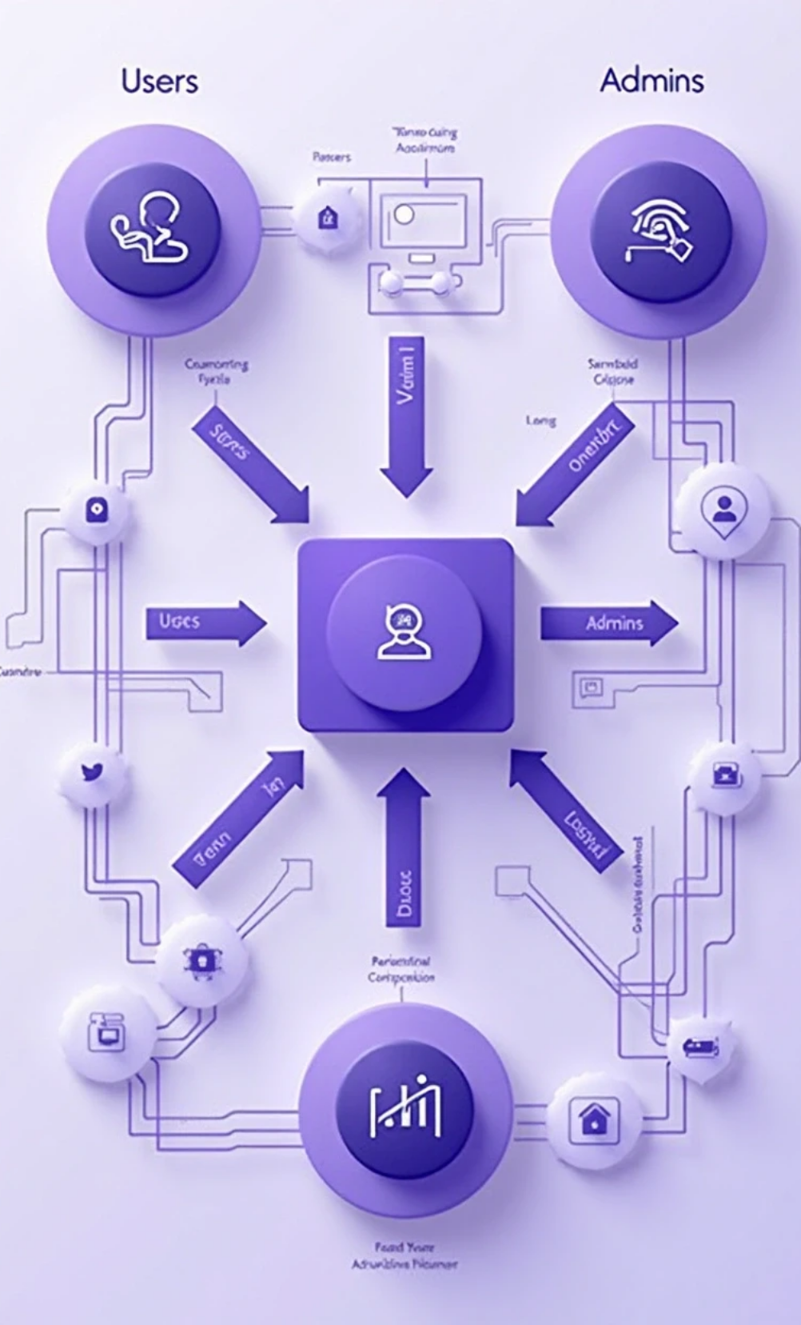


Data Flow Overview
1
Context Diagram
A visual representation of how different entities interact with the OneHood system.
2
External Entities
Users (residents), Admins (moderators)interact with the system.
3
Data Interactions
Users input registration info and content for socializing with their community.

Slide 5



Core Modules Overview
This presentation outlines the core modules of our platform, each designed to enhance user experience and community engagement. Each module plays a unique role in maintaining efficient operations and fostering interaction among residents.
User Registration Module
Community Feed Module
Marketplace Module
Manages user registrations and make the user can switch the dark mode toggle for better usage.
The main hub for social interaction, featuring photo posting for community engagement.
Facilitates local commerce by allowing residents to buy, sell, and rent items or services within the community.

Slide 6



Additional Features Overview
Posting Module
A place for expressing their emotions by posting the word what’s on their mind with photos.
Hood Calendar Module
Live Noticeboard Module
A shared calendar for tracking local events, ensuring residents are informed about community happenings.
A digital noticeboard for high-priority announcements, ensuring important information is easily visible to all users.
2
1
3

Slide 7



Expected Outcomes
1
Connected Community
OneHood helps to connect the people in the community and socializing them.
2
Increased Engagement
Features like photo and text posts will enhance community bonds.
3
Centralized Information Access
OneHood will be the go-to source for neighborhood information.

Slide 8

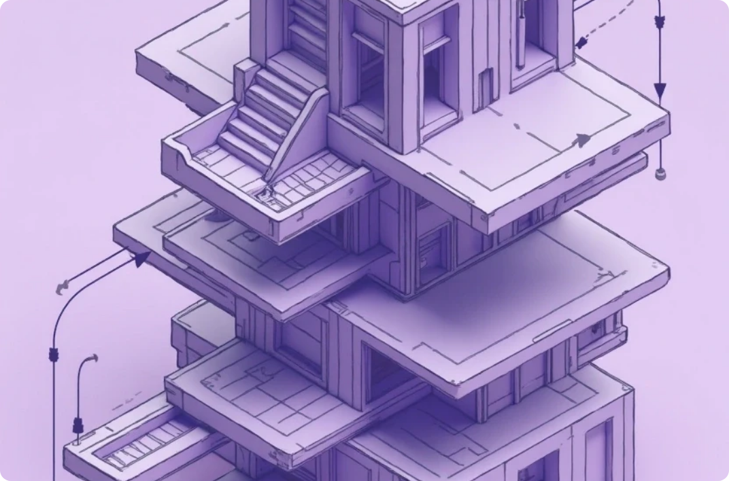

Conclusion of OneHood
Robust Community Solution
Future Expansion
Building Stronger Communities
OneHood addresses the challenges of digital neighborhood communication with a focus on security and user engagement.
The modular architecture allows for additional features, ensuring long-term relevance and utility.
OneHood is not just an app; it's a tool for creating vibrant and supportive neighborhoods, enhancing the overall quality of community life.

